Slide 1

CS375 Information Security
Lecture 7
Key Management for Public-Key Cryptosystems
Dr. Anwar Ghani
Lecturer
Department of Computer Science
Internal Islamic University, Islamabad
Email: anwar.ghani@iiu.edu.pk

Slide 2
Key Management
Public-key encryption helps to address key distribution problems
Two aspects
  distribution of public keys
  use of public-key encryption to distribute secret keys
Distribution of Key based on:
  public announcement
  publicly available directory
  public-key authority
  public-key certificates
CS671 NS - Spring 2015
Notes:
One of the major roles of public-key encryption has been to address the problem of key distribution, with two distinct aspects: the distribution of public keys, and the use of public-key encryption to distribute secret keys.

Slide 3
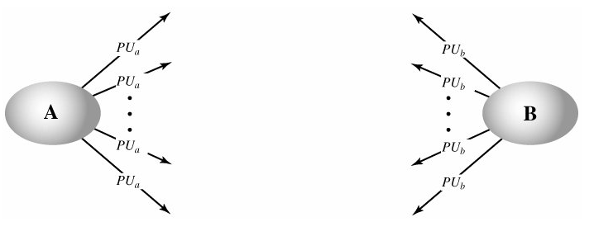
Public Announcement
Users distribute public keys to recipients or broadcast to community at large
  e.g. append PGP keys to email messages or post to news groups or email list
Major weakness is forgery
  anyone can create a key claiming to be someone else and broadcast it
  until forgery is discovered can masquerade as claimed user
CS671 NS - Spring 2015
Notes:
The point of public-key encryption is that the public key is public, hence any participant can send his or her public key to any other participant, or broadcast the key to the community at large. Its major weakness is forgery, anyone can create a key claiming to be someone else and broadcast it, and until the forgery is discovered they can masquerade as the claimed user.

Slide 4
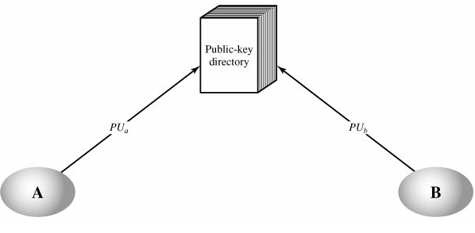
Publicly Available Directory
Greater security by registering keys with a public directory
Directory must be trusted with properties
  contains {name, public-key} entries
  participants register securely with directory
  participants can replace key at any time
  directory is periodically published
  directory can be accessed electronically
Still vulnerable to tampering or forgery
CS671 NS - Spring 2015
Notes:
A greater degree of security can be achieved by maintaining a publicly available dynamic directory of public keys. Maintenance and distribution of the public directory would have to be the responsibility of some trusted entity or organization. This scheme is clearly more secure than individual public announcements but still has vulnerabilities to tampering or forgery.

Slide 5
Public-Key Authority
Improve security by tightening control over distribution of keys from directory
Has properties of directory
Users know public key for the directory
Users interact with directory to obtain any desired public key securely
  does require real-time access to directory when keys are needed
CS671 NS - Spring 2015
Notes:
Stronger security for public-key distribution can be achieved by providing tighter control over the distribution of public keys from the directory. It requires users to know the public key for the directory, and that they interact with directory in real-time to obtain any desired public key securely. Note that a total of seven messages are required, as shown next.

Slide 6
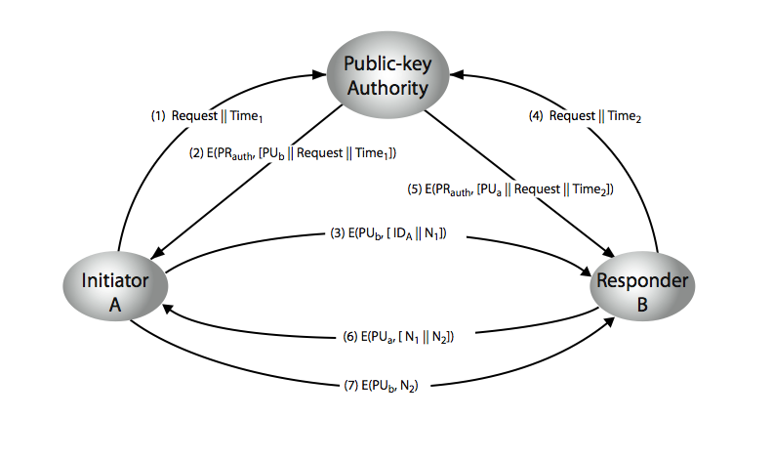
Public-Key Authority
CS671 NS - Spring 2015
Notes:
Stallings Figure 10.3 “Public-Key Authority” illustrates a typical protocol interaction. See text for details of steps in protocol.

Slide 7
Public-Key Certificates
Certificates allow key exchange without real-time access to public-key authority
A certificate binds identity to public key
  usually with other info such as period of validity, rights of use etc
All contents signed by a trusted Public-Key or Certificate Authority (CA)
Can be verified by anyone who knows the public-key authority’s public-key
CS671 NS - Spring 2015
Notes:
An further improvement is to use certificates, which can be used to exchange keys without contacting a public-key authority, in a way that is as reliable as if the keys were obtained directly from a public-key authority. A certificate binds an identity to public key, with all contents signed by a trusted Public-Key or Certificate Authority (CA). This can be verified by anyone who knows the public-key authorities public-key.
One scheme has become universally accepted for formatting public-key certificates: the X.509 standard. X.509 certificates are used in most network security applications, including IP security, secure sockets layer (SSL), secure electronic transactions (SET), and S/MIME. Will discuss it in much more detail later.

Slide 8
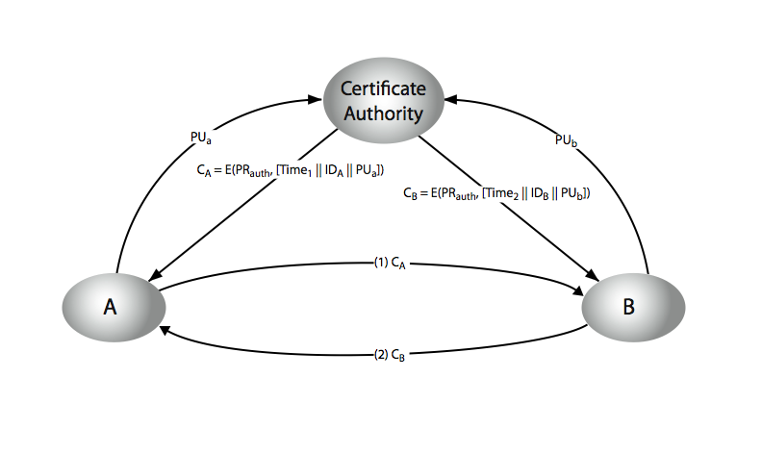
Public-Key Certificates
CS671 NS - Spring 2015
Notes:
Stallings Figure 10.4 “Public-Key Certificates” illustrates such a scheme. See text for details of steps in protocol.

Slide 9
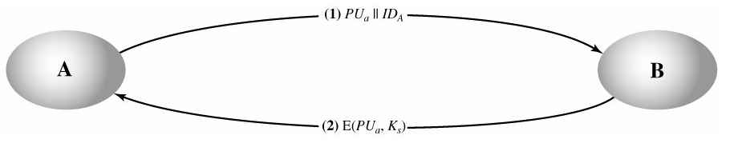
Simple Secret Key Distribution
Proposed by Merkle in 1979
  A generates a new temporary public key pair
  A sends B the public key and their identity
  B generates a session key K sends it to A encrypted using the supplied public key
  A decrypts the session key and both use
Problem is that an opponent can intercept and impersonate both halves of protocol
CS671 NS - Spring 2015
Notes:
An extremely simple scheme was put forward by Merkle [MERK79]. But it is insecure against an adversary who can intercept messages and then either relay the intercepted message or substitute another message. Such an attack is known as a man-in-the-middle attack [RIVE84].

Slide 10
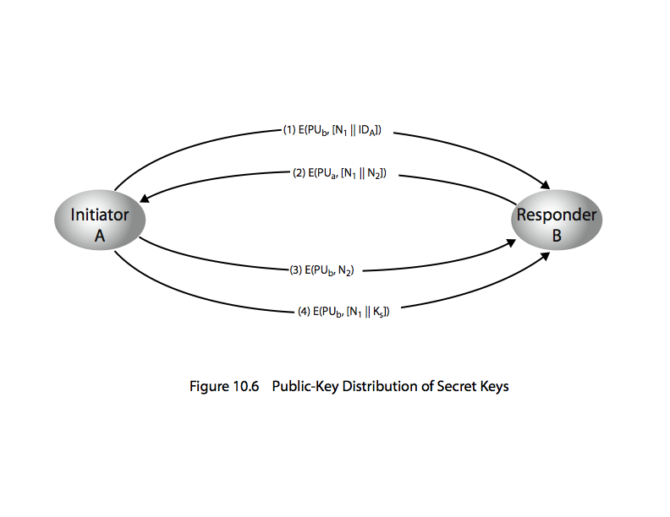
Public-Key Distribution of Secret Keys
Use previous methods to obtain public-key
Can use for secrecy or authentication
encryption to protect message contents
Have several alternatives for negotiating a suitable session
CS671 NS - Spring 2015
Notes:
Once public keys have been distributed or have become accessible, secure communication that thwarts eavesdropping, tampering, or both, is possible. However, few users will wish to make exclusive use of public-key encryption for communication because of the relatively slow data rates that can be achieved. Accordingly, public-key encryption provides for the distribution of secret keys to be used for conventional encryption.

Slide 11
Hybrid Key Distribution
Retain use of private-key KDC
Shares secret master key with each user
Distributes session key using master key
Public-key used to distribute master keys
  especially useful with widely distributed users
Rationale
  performance
  backward compatibility
CS671 NS - Spring 2015
Notes:
Yet another way to use public-key encryption to distribute secret keys is a hybrid approach in use on IBM mainframes [LE93]. This scheme retains the use of a key distribution center (KDC) that shares a secret master key with each user and distributes secret session keys encrypted with the master key. A public key scheme is used to distribute the master keys. The addition of a public-key layer provides a secure, efficient means of distributing master keys. This is an advantage in a configuration in which a single KDC serves a widely distributed set of users.

Slide 12
Diffie-Hellman Key Exchange
First public-key scheme proposed by Diffie & Hellman in 1976 based on public key concepts
Practical method for public exchange of secret key
Used in a number of commercial products
Security relies on the difficulty of computing discrete logarithms (similar to factoring)
CS671 NS - Spring 2015
Notes:
The idea of public key schemes, and the first practical scheme, which was for key distribution only, was published in 1977 by Diffie & Hellman. The concept had been previously described in a classified report in 1970 by Williamson (UK CESG) - and subsequently declassified in 1987, see [ELLI99].

Slide 13
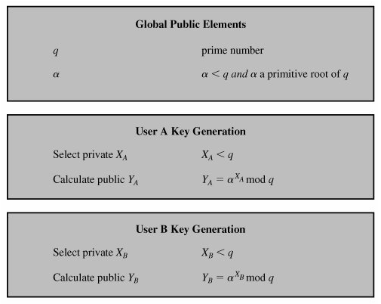
Diffie-Hellman Algorithm
CS671 NS - Spring 2015
Notes:
In the Diffie-Hellman key exchange algorithm, there are two publicly known numbers: a prime number q and an integer a that is a primitive root of q. The prime q and primitive root a can be common to all using some instance of the D-H scheme. Note that the primitive root a is a number whose powers successively generate all the elements mod q. Users Alice and Bob choose random secrets x's, and then "protect" them using exponentiation to create their public y's. For an attacker monitoring the exchange of the y's to recover either of the x's, they'd need to solve the discrete logarithm problem, which is hard.

Slide 14
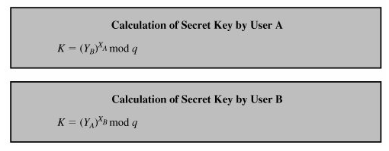
Diffie-Hellman Algorithm
K= (YB)^{XA} mod q
= (a^{XB} mod q)^{XA} mod q
= (a^{XB})^{XA} mod q
= a^{XBXA} mod q
= (a^{XA})^{XB} mod q
= (a^{XA} mod q)^{XB} mod q
= (YA)^{XB} mod q
CS671 NS - Spring 2015
Notes:
In the Diffie-Hellman key exchange algorithm, there are two publicly known numbers: a prime number q and an integer a that is a primitive root of q. The prime q and primitive root a can be common to all using some instance of the D-H scheme. Note that the primitive root a is a number whose powers successively generate all the elements mod q. Users Alice and Bob choose random secrets x's, and then "protect" them using exponentiation to create their public y's. For an attacker monitoring the exchange of the y's to recover either of the x's, they'd need to solve the discrete logarithm problem, which is hard.

Slide 15
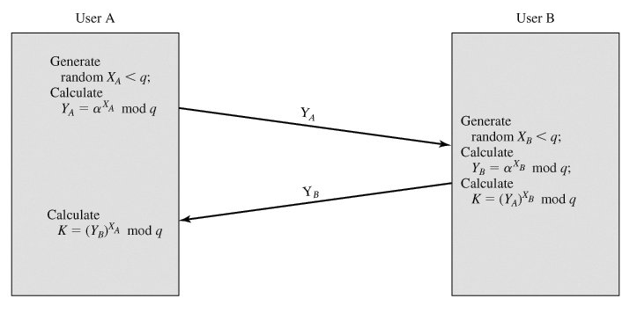
Diffie-Hellman Key Exchange
CS671 NS - Spring 2015
Notes:
The actual key exchange for either party consists of raising the others "public key' to power of their private key. The resulting number (or as much of as is necessary) is used as the key for a block cipher or other private key scheme. For an attacker to obtain the same value they need at least one of the secret numbers, which means solving a discrete log, which is computationally infeasible given large enough numbers. Note that if Alice and Bob subsequently communicate, they will have the same key as before, unless they choose new public-keys.

Slide 16
Diffie-Hellman Example
Users A & B who wish to swap keys:
Agree on prime q=353 and a=3
Select random secret keys:
  A chooses x_{A}=97,
  B chooses x_{B}=233
Compute respective public keys:
  y_{A}=3⁹⁷ mod 353 = 40 (A)
  y_{B}=3²³³ mod 353 = 248 (B)
Compute shared session key as:
  K_{AB}= y_{B}^{xA} mod 353 = 248⁹⁷ = 160 (A)
  K_{AB}= y_{A}^{xB} mod 353 = 40²³³ = 160 (B)
CS671 NS - Spring 2015
Notes:
Here is an example of Diffie-Hellman from the text.

Slide 17
Man-in-the-Middle Attack
Suppose Alice and Bob wish to exchange keys, and Darth is the adversary
The attack proceeds as follows
Darth generates two random private keys XD1 and XD2 and then computes the corresponding public keys YD1 and YD2
Alice transmits YA to Bob
Darth intercepts YA and transmits YD1 to Bob
Darth also calculates K2 = (YA)^{XD2} mod q
Bob receives YD1 and calculates K1 = (YD1)^{XB} mod q
Bob transmits XA to Alice
Darth intercepts XA and transmits YD2 to Alice
Darth calculates K1 = (YB)^{XD1} mod q
Alice receives YD2 and calculates K2 = (YD2)^{XA} mod q
CS671 NS - Spring 2015
Notes:
Here is an example of Diffie-Hellman from the text.

Slide 18
Man-in-the-Middle Attack
Bob & Alice think that they share a secret key, but instead Bob & Darth share secret key K1 and Alice & Darth share secret key K2
All future communication between Bob & Alice is compromised in the following way
Alice sends an encrypted message M: E(K2, M)
Darth intercepts the encrypted message and decrypts it, to recover M
Darth sends Bob E(K1, M) or E(K1, M'), where M' is any message
  In the first case, Darth simply wants to eavesdrop on the communication without altering it.
  In the second case, Darth wants to modify the message going to Bob.
The key exchange protocol is vulnerable to this attack because it does not authenticate the participants
This vulnerability can be overcome with the use of digital signatures and public-key certificates
CS671 NS - Spring 2015
Notes:
Here is an example of Diffie-Hellman from the text.

